Slide 1


Project Presentation (KCS 753) H! Drive
KIET Group of Institutions, Ghaziabad
(An ISO – 9001: 2008 Certified & ‘A+’ Grade accredited Institution by NAAC)
Guide : Mr. Amit Kumar Singh Sanger
Project Members
1. Akshat Singh 2000290120018 (CS 8A)
2. Aman Verma 2000290120021 (CS 8A)
3. Anmol Patel 2000290120027 (CS 8A)

Slide 2
Problem Statement
As we have seen in the current existing system that people face difficulty in hiring driver for their own cars so they try to rent a car to travel. So, to overcome this problem we are developing our App “Hi! Drive" in which we will providing drivers on rental to customer who have their own car but are not able to drive. In which they can easily search drivers on job nearby them and hire them on duty.

Slide 3
Objectives
Maintain driver’s database.
Make driver list available to user from the nearest area.
Token based authorization for users
Self-registration for drivers and users.

Slide 4
Technology Used
Front-end:
React JS
HTML , CSS, JavaScript
Backend:
REST framework
Node JS
Express JS
MongoDB

Slide 5
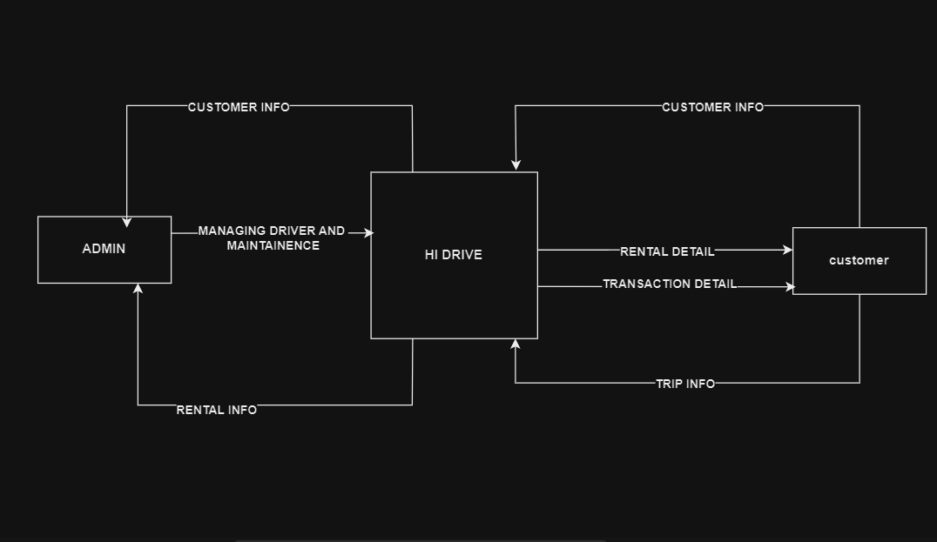
0 LEVEL DFD

Slide 6
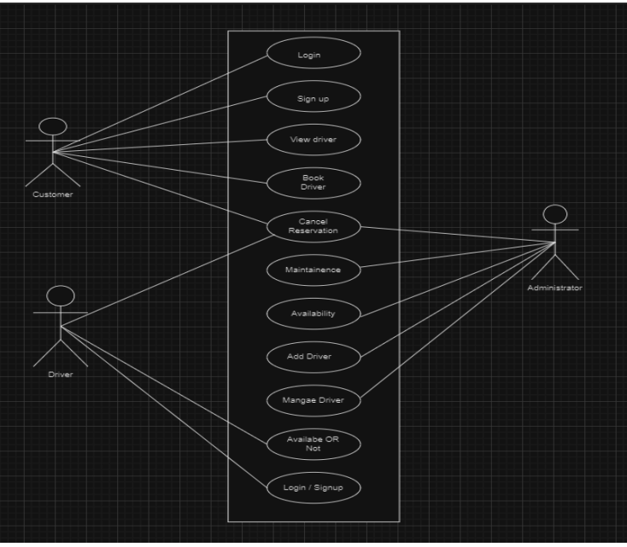
USE CASE diagram

Slide 7
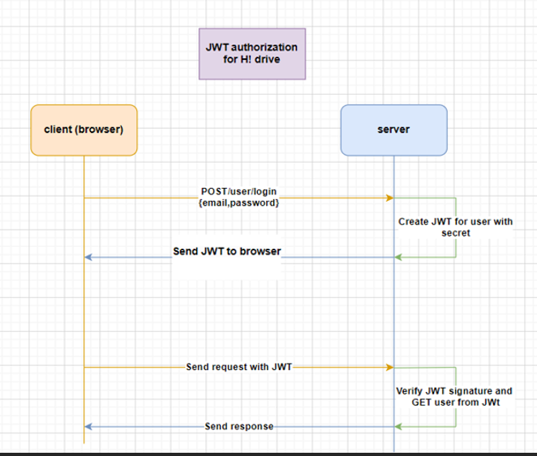
Token based authorization

Slide 8
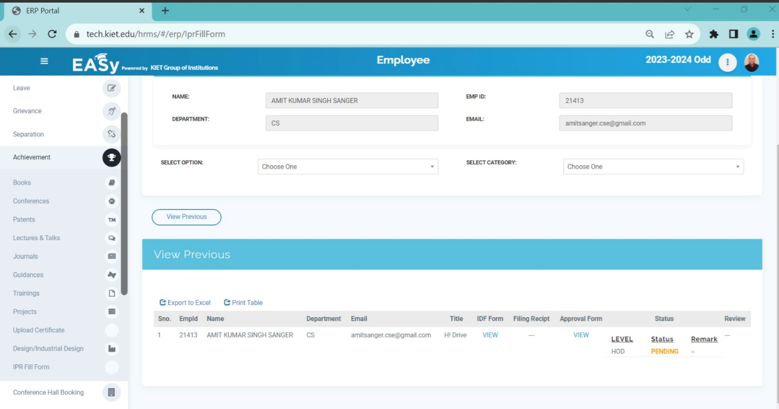
Patent Status
Completed and sent to mentor, pending for publication.

Slide 9
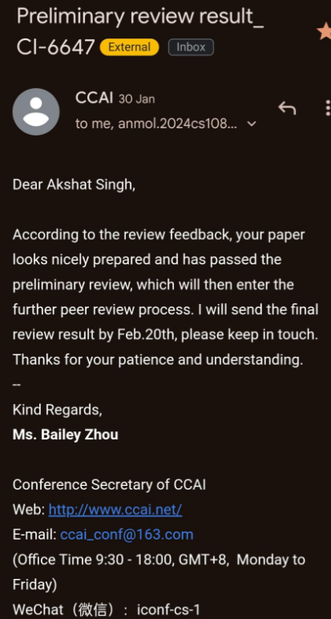
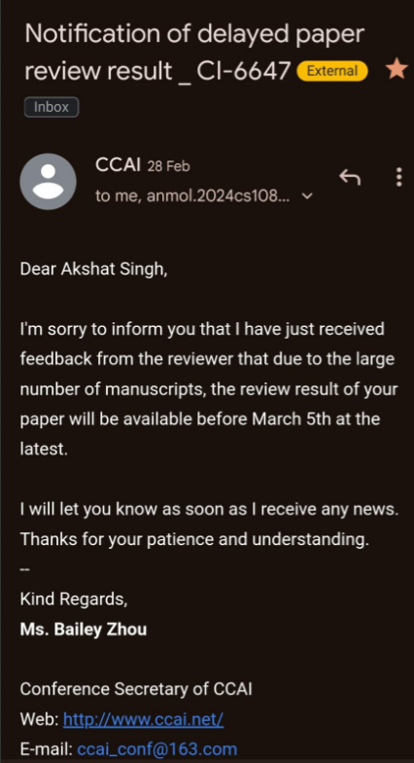
Research Paper Status
Completed and sent for publication and passed the preliminary phase.

Slide 10
Project Status
Completed 100%
.

